Slide 1
Directing Resources to Address COVID-19 Health Inequities
Team 4
Jiadai Yu, Shu Wang, Sixuan Wang, Yuesen Zhang, Fanfei Zhao

Slide 2
Agenda
01
02
03
Introduction
Explanatory Analysis
Conclusion
04
References
1.1 Motivation
1.2 Data Dictionary
2.1 Social Classes
2.2 Races and Ethnicity
2.3 Age Groups and Genders
2.4 Geographic Difference
Notes:
2的heading精简短一点

Slide 3
Introduction
COVID-19 exacerbates health inequities, some populations are disproportionately impacted.
Disease spreads with the population mixing and impacts the health of whole society.
Identify the most affected populations.
Reallocate the medical resources to improve equity and health in all communities.
Social determinants
Race and ethnicity
Age and gender
Healthy place index

Slide 4
Data Dictionary
Metric: Include positive_rate, 7-day cases rate.
Demographic: Race-ethnicity,age,gender,among others.
Demographic category: subcategory of demographic characteristics.
Social determinants: Including income,income_cumulative,crowding,insurance among others.
Social Tier: A subcategory of social determinants.
Location: The name in county level in California.
Value: The exact value based on given metrics. rates based on per 100,K.

Slide 5
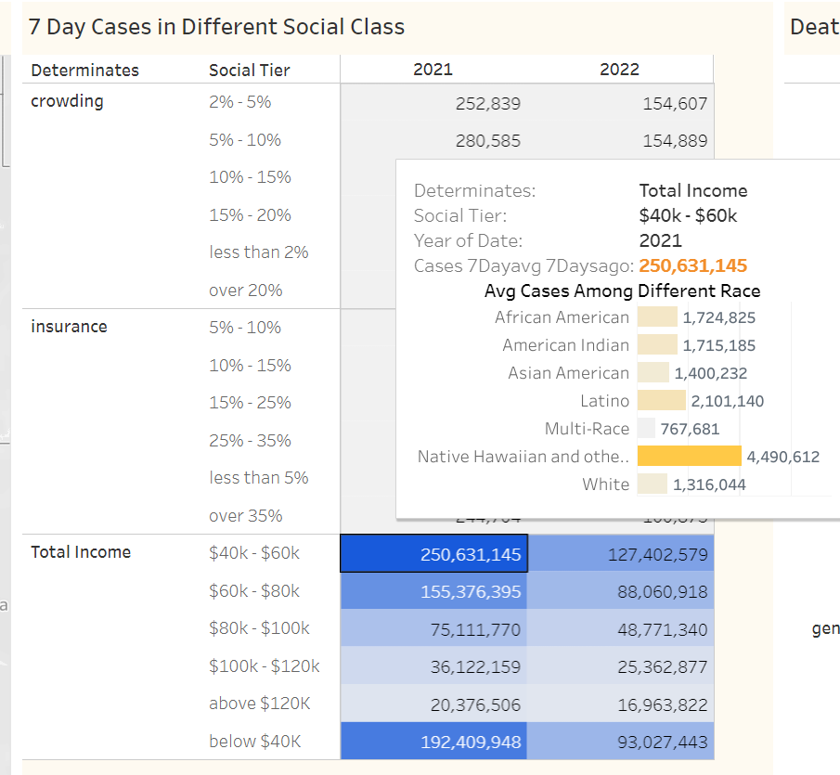
7-Day Cases in Different Social Classes
Essential workers are affected most
Colored people have higher possibilities to get COVID VS White people
Survival pressure
Higher opportunities of exposing to risk factors
Low protection awareness
Limited social resources

Slide 6
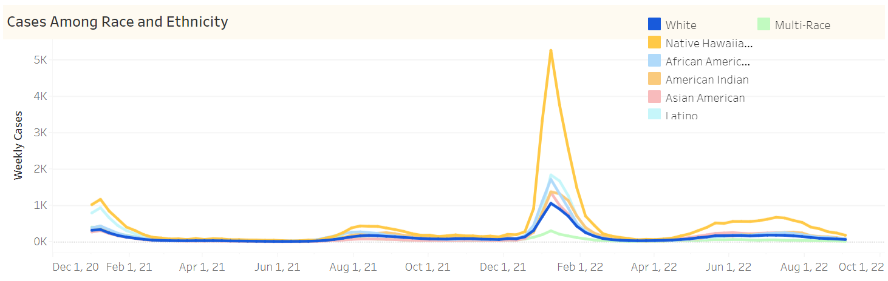
Review of case rate between ethnicity groups
Findings
An obvious peak around Jan 2022, indicates the spread of Omicron.
Relative high case rate for Native Hawaiian and low rate for Asian American
Notes:
The above results show significant difference in total cases within different ethnicity groups. A high confirmed case rate in Native Hawaiian may due to the fact that this ethnicity group lives in a certain area and is easily get infected if the virus has spread to their living habitat. The relative low confirmed case rate in Asian American may due to the fact that they tend to be more cautious facing this virus and did more protective measures compared to other ethnicity groups.

Slide 7
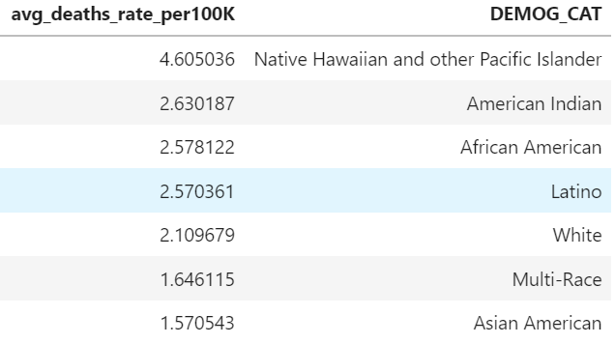
Review of death rate between ethnicity groups
Findings
Overall,the death rate is in positive relationship with confirmed cases. A higher confirmed case rate indicates higher death rate within ethnicity groups.
Notes:
Overall,the death number is in positive relationship to confirmed cases.A higher confirmed case rate indicates higher death rate within groups.

Slide 8
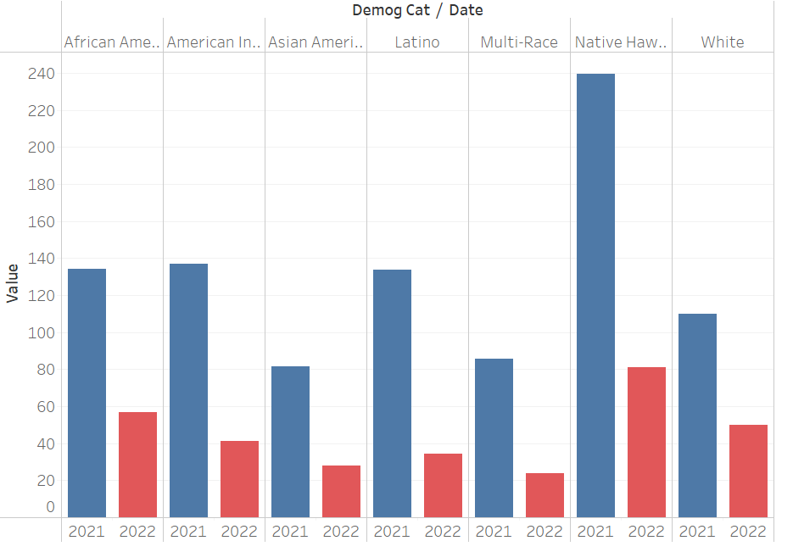
Consistent death rate rank and conclusion
For native hawaiians:
Publicize precautions in their neighborhood. Take further steps.
For African american:
Reallocate medica resources,provide primary health care access to their neighborhood.
Notes:
Combined with comparison of death rate between 2021 and 2022,it is clear that the rank of death rate among all ethnicity groups is the same as Omicron branch becomes the most spread one. There's no significant factors that affects the death rate between ethnicity groups other than case rate.

Slide 9
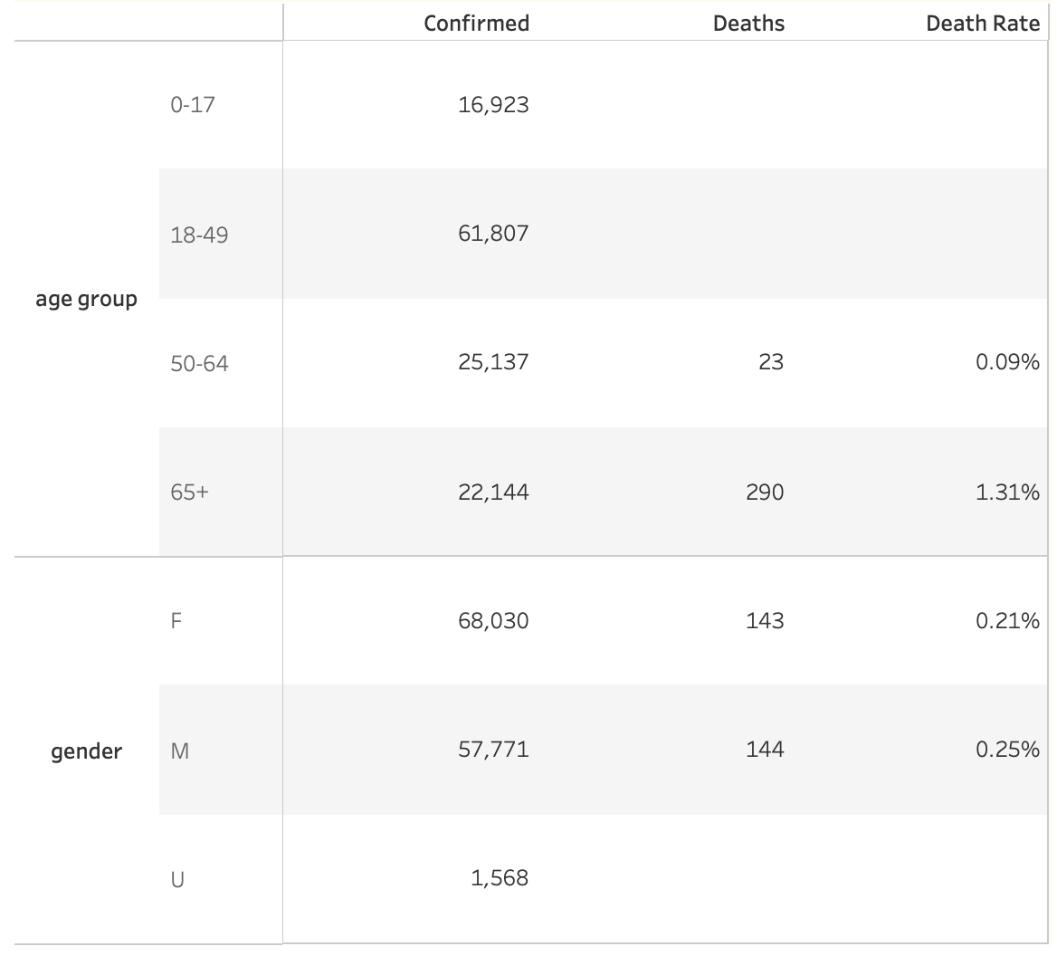
30-Day Cases Group by Age and Gender
Most vulnerable group: age 65+
Age | 45
Gender | Male
Allergies | None
Location | Spain
Covid-19 | Yes
Vaccine | Yes
Relationship between death rate and gender is not significant

Slide 10
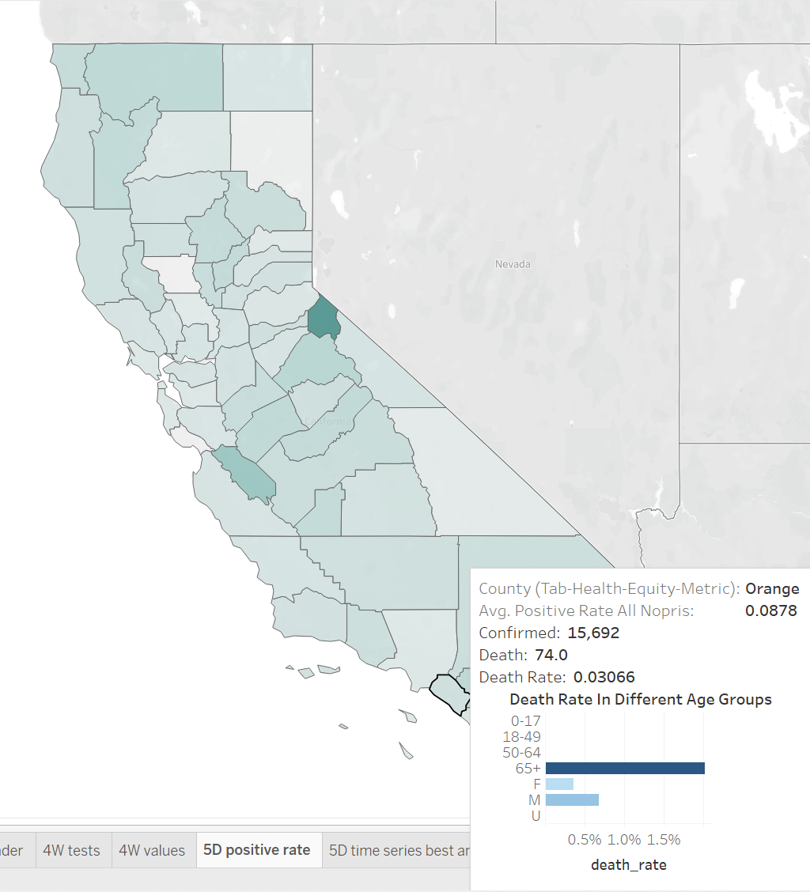
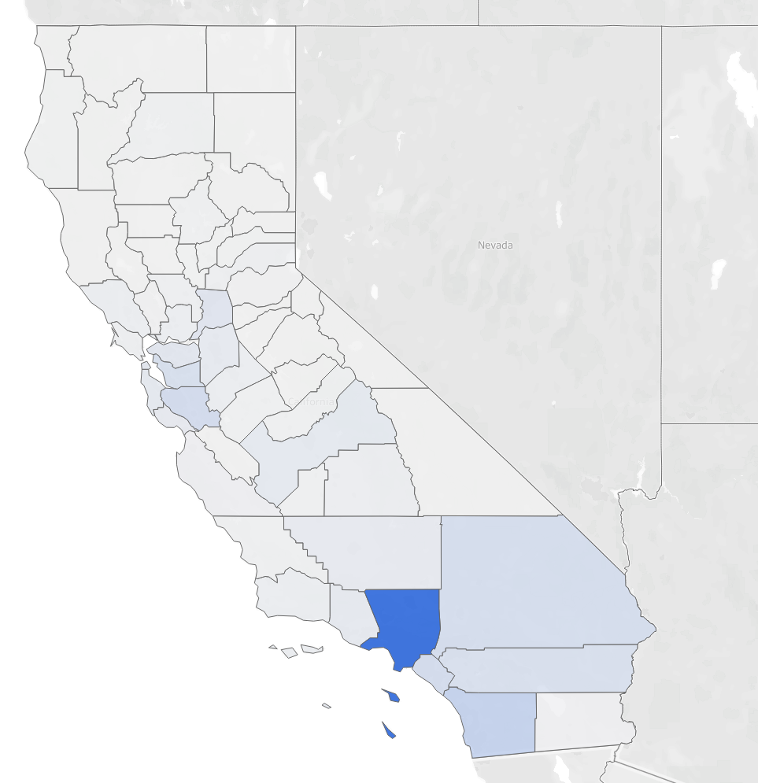
Geographic View of Test Positive Rate
Positive Rate = cases/tests × 100%
Indicating the severity of the epidemic
and the adequacy of tests
No obvious relationship between death rate and positive rate

Slide 11
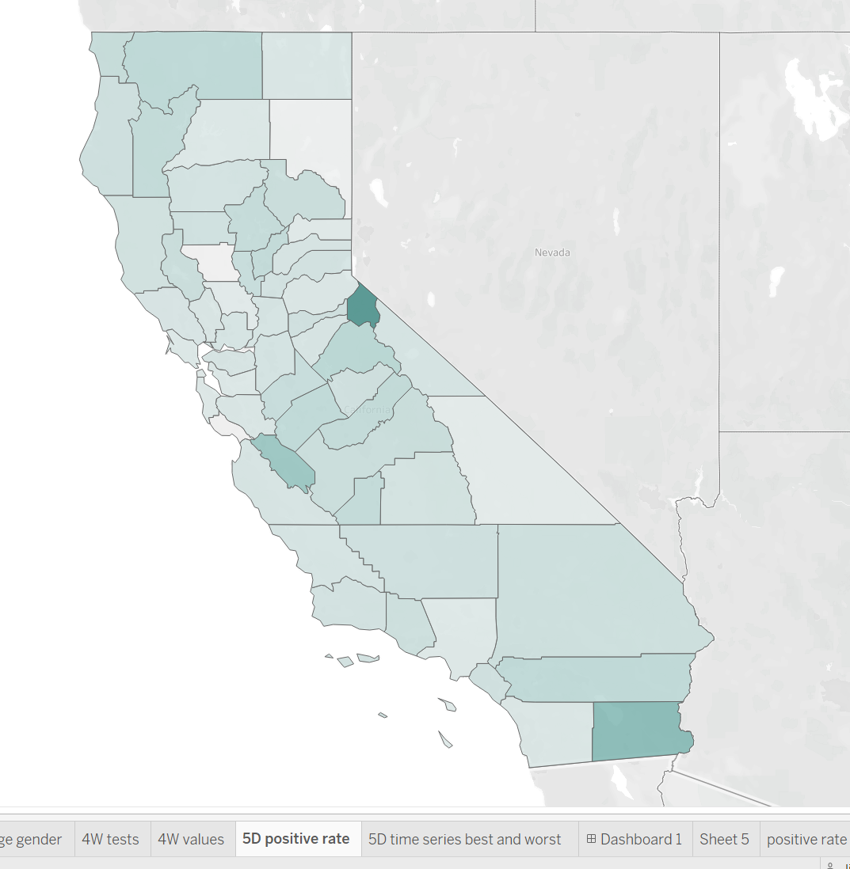
Geographic View of Test Positive Rate
Santa Cruz
Low positive rate
3.55%
Imperial
High positive rate
22.21%
Notes:
Thank you Wilson, Covid-19 spreads with population movements, therefore geographic factors are very relevant to the epidemic. The graph shows the distribution of test positive rate by county,
The difference between counties is very significant, with the lowest rate in Santa Cruz being only 3.55%, while in Imperial, the positivity rate is up to 22.21%.

Slide 12
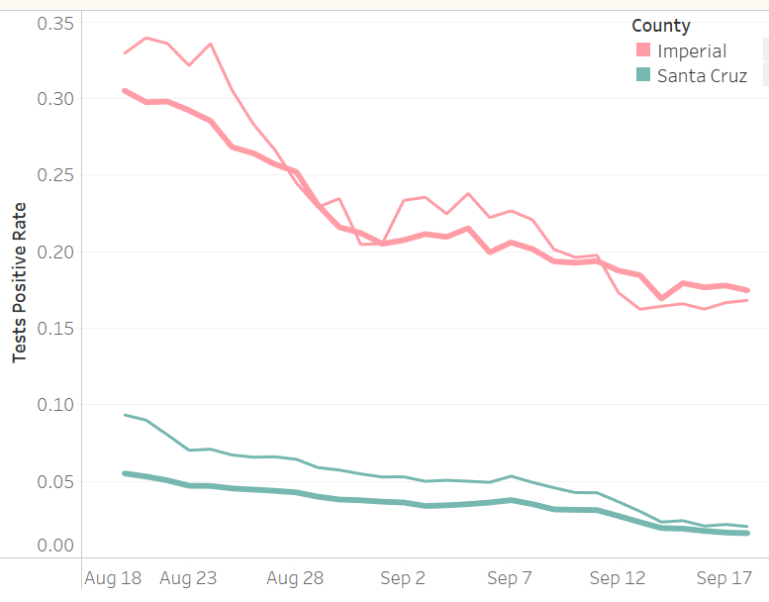
Differences in test positivity rates
Healthy Place Index (HPI)
a composite measure of socioeconomic opportunity, based on neighborhood sectors.
Population in the first HPI quartile is marked as low-hpi (thin line)
Overall population of the county (thick line)
Severity of the epidemic and the adequacy of tests
Inequity
Effectiveness of policy
Notes:
Now let’s have a closer look at the regional differences between these two types of counties. Healthy place index is a composite measure of socioeconomic opportunity, based on neighborhood sectors, each county's population is divided into quartiles based on Healthy place index, and the first quartile is marked as low-hpi. represented by the thin lines.
we can see that population live in low healthy places index neighborhoods tends to have higher positive rate than the county average, indicating more severe epidemic and inadequate testing.
Further, the higher the positivity rate, the more significant the differences in positivity rates across population, indicating inequity
Thirdly, counties with overall lower positivity rates has steadily decreasing positive rate while that of the other type of county is more turbulent, indicating less effective control of COVID.

Slide 13
Conclusion
COVID-19 exacerbates health inequities,
spreads with the population mixing and impacts the health of whole society.
Overlap
historical traditions, racial discrimination, etc.
Reallocate the medical resources to these most vulnerable groups and hardest-hit areas.
Address health inequality.
Reduce disease transmission in all communities.
Social determinants
Race and ethnicity
Age and gender
Healthy place index
Notes:
From the above analysis, we found that the most impacted population are Essential workers, Native Hawaiian and other Pacific Islander, people aged more than 65 and live in low hpi neighborhood.
Notably, because of historical traditions, and racial discrimination, there are overlap between these populations, so it’s necessary to join these results instead of analyze Isolatedly.
Based on the findings, it’s suggested reallocate the medical resources for these most vulnerable groups and hardest-hit areas, address the health inequality, thus to reduce disease transmission and protect the health of all communities.

Slide 14
References
Kayitsinga, J., & Martinez, R. O. (2021, August 8). Social and Structural Inequalities and COVID-19 in the United States. Social and Structural Inequalities and COVID-19 in the United States - Julian Samora Research Institute - Michigan State University. Retrieved October 18, 2022, from https://jsri.msu.edu/publications/nexo/vol/no-1-fall-2020/social-and-structural-inequalities-and-covid-19-in-the-united-states
California population 2022. California Population 2022 (Demographics, Maps, Graphs). (n.d.). Retrieved October 18, 2022, from https://worldpopulationreview.com/states/california-population
Harris, M. (2020, June 9). To address COVID-19 disparities, PCDC urges New York State to invest in Primary Care. Primary Care Development Corporation. Retrieved October 18, 2022, from https://www.pcdc.org/covid-19-disparities-new-york-testimony/?creative=490896925902&keyword=covid-19+racial+disparities&matchtype=e&network=g&device=c&gclid=Cj0KCQjwnbmaBhD-ARIsAGTPcfXq-M9l49l5jql7F0aEgiklG73BvC7CeeCZBjkwl2zwsst4lXNrgOIaAtu-EALw_wcB
Blueprint For a Safer Economy: Equity Focus https://www.cdph.ca.gov/Programs/CID/DCDC/Pages/COVID-19/CaliforniaHealthEquityMetric.aspx

Slide 15
Thanks!
Any questions?

